Slide 1
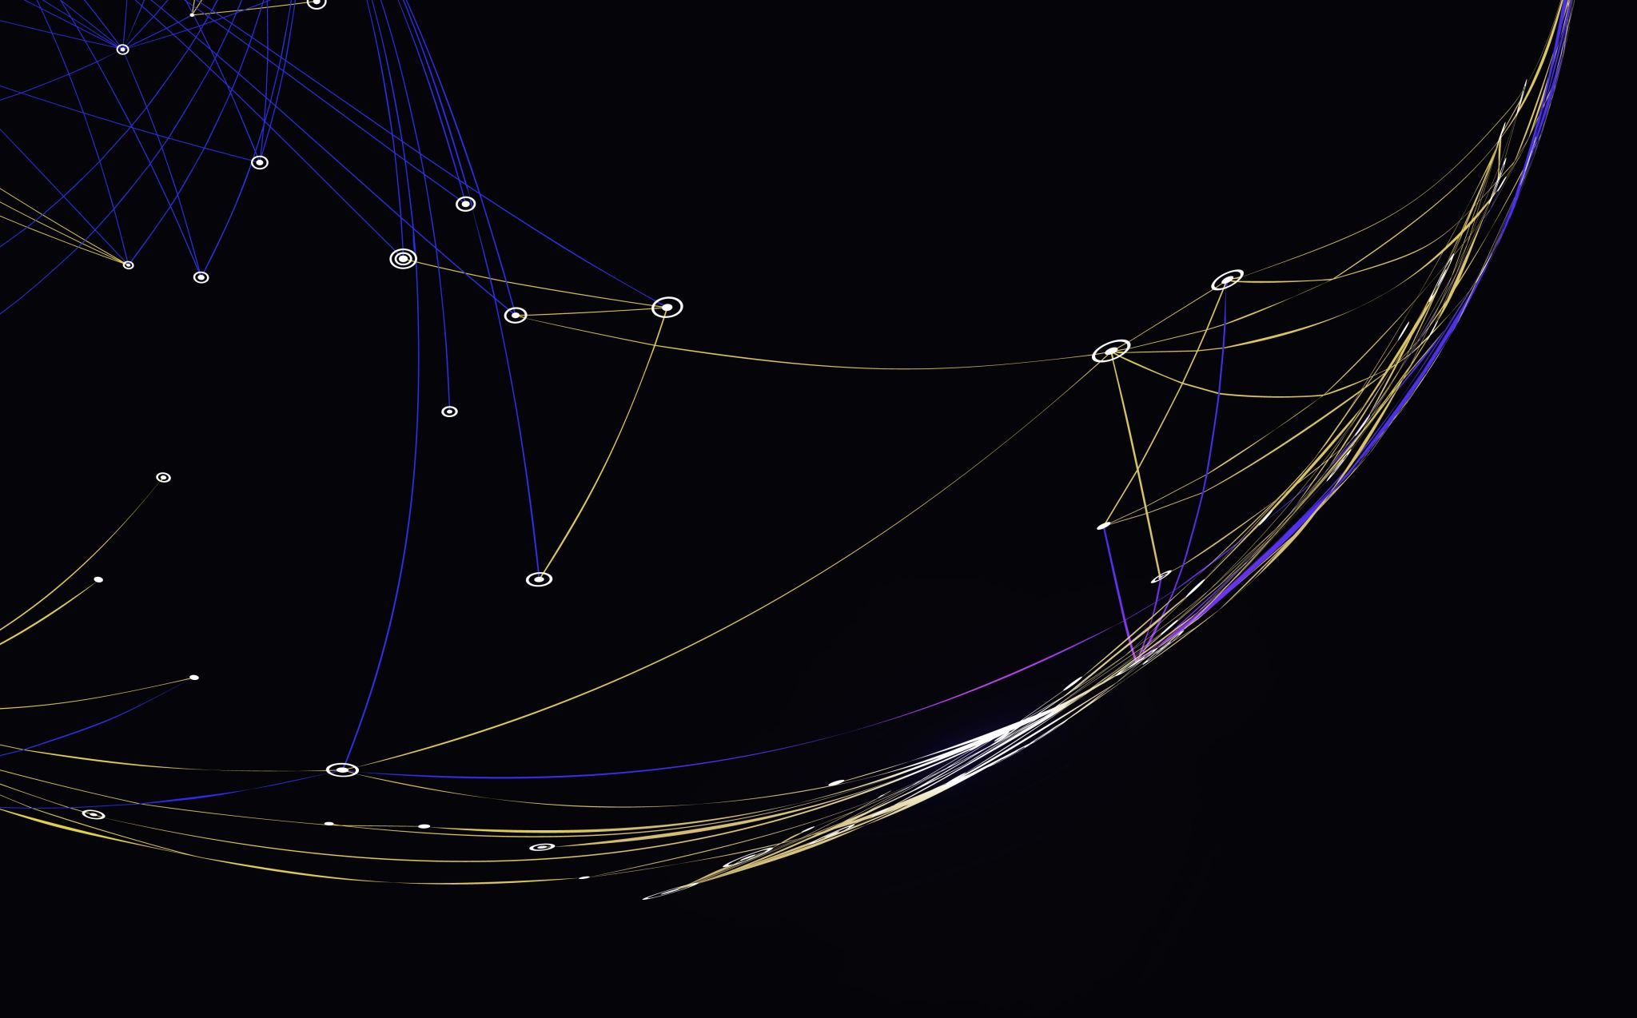

Understanding and Predicting Patient No-Show Rates in Healthcare
Final Project- Data 602 Shaya Engelman
May 5th, 2024 Professor Schettini

Slide 2
Agenda
Abstract
Introduction
Methodology
Experimentation
Conclusion
References

Slide 3
Abstract
This research project aims to predict patient no-shows for medical appointments, a significant issue in healthcare due to the implications for resource utilization and revenue. Utilizing a dataset of over 100,000 medical appointments in Brazil, the study conducts a thorough data preparation process, including cleaning, anomaly fixing, and feature engineering. The data encompasses patient demographics, medical history, sms reminders, and appointment attendance. The data interacts with no-show rates differently for same-day appointments versus non same-day appointments and is split in two to account for that difference. The study finds the key predictor of no-shows is indeed same-day versus non same-day. Furthermore, the study reveals some other valuable predictors such as sms reminders. Various recommendations are included based on insights from the research. This project underscores the potential of data science in improving healthcare and its outcomes.

Slide 4

Introduction

Slide 5
Introduction
Patient no-shows pose significant challenges in healthcare:
Wasted resources
Diminished revenue
Suboptimal patient outcomes
Predictive analytics can help anticipate no-shows:
Identify patients likely to miss appointments
Enable targeted interventions
Schedule alternative activities
Objective:
Forecast patient attendance accurately
Distinguish between honor and cancellation/no-show
Goal:
Equip healthcare providers with practical insights
Enhance appointment scheduling
Allocate resources effectively
Improve patient engagement strategies
Motivation:
Real-world challenges faced by healthcare professionals
Personal experiences of the presenter's wife, a Registered Dietitian
Urgency to develop effective predictive models

Slide 6

Methodology

Slide 7
Data Access:
Dataset: 100,000 records of healthcare appointments in a Brazilian hospital
Data Preparation:
Handle corrupted data
Convert categorical data to dummy variables
Exploratory Data Analysis (EDA):
Explore variable distributions
Visualize correlation heatmap
Feature Engineering:
Generate columns:
Day of week
Days between appointments
Same-day appointment indicator
Model Building:
Generate a dummy model
Generate a GLM logistic regression model
Split data by same-day column:
Generate dummy models for each split
Generate new logistic regression models for each split
Review Coefficients and Predictions:
Analyze coefficients of logistic regression models
Make predictions based on the models
Clean the data

Slide 8
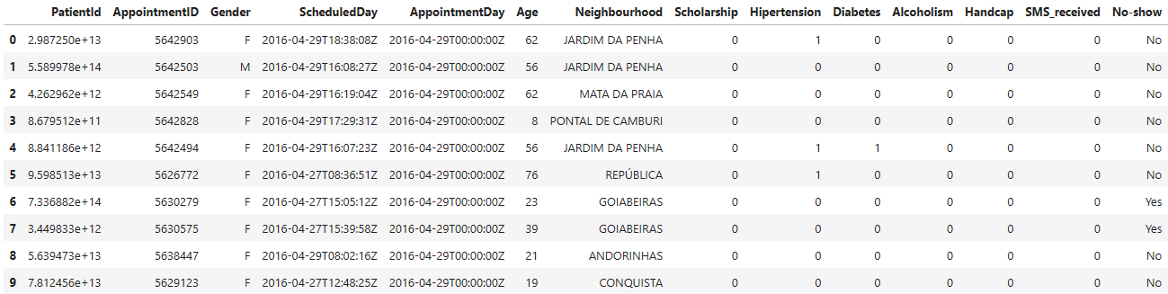
Data Access
The data is sourced from Kaggle and contains 100,000 records of patients for various healthcare needs.

Slide 9
Data Cleaning
The columns were renamed due to typo and different conventions
Binary string columns such as gender and no-show were replaced with integers
ID columns were replaced with strings to better reflect their value
Date columns were converted to datetime format to help with data analyses

Slide 10
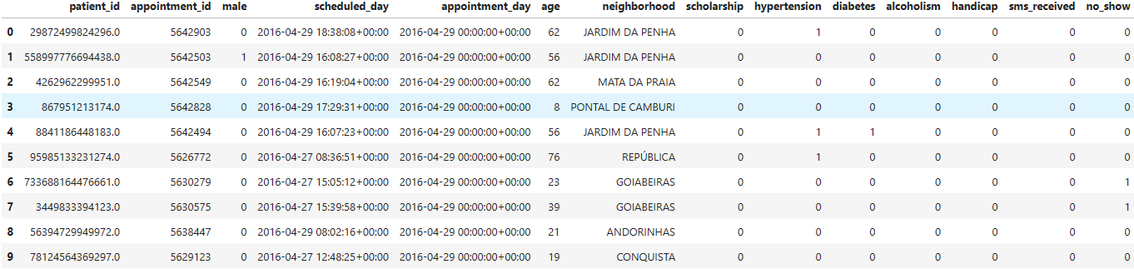

Slide 11

Exploratory Data Analysis

Slide 12
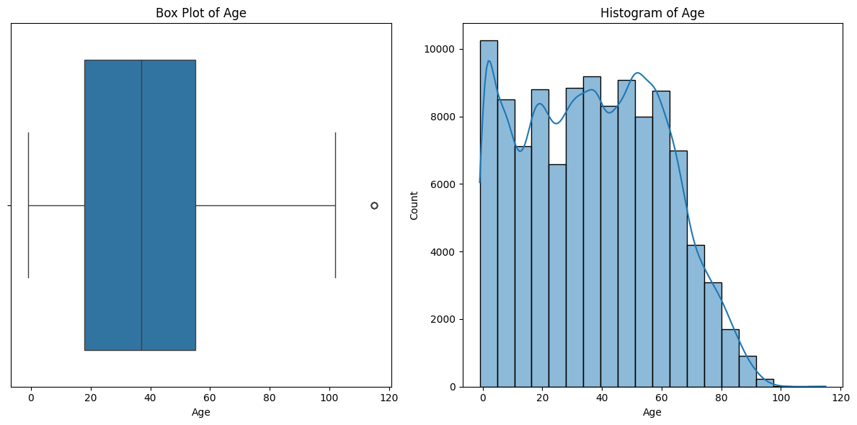
Distribution of Age
Negative value
High outlier at 115
As expected distribution
Large amont of 0s

Slide 13
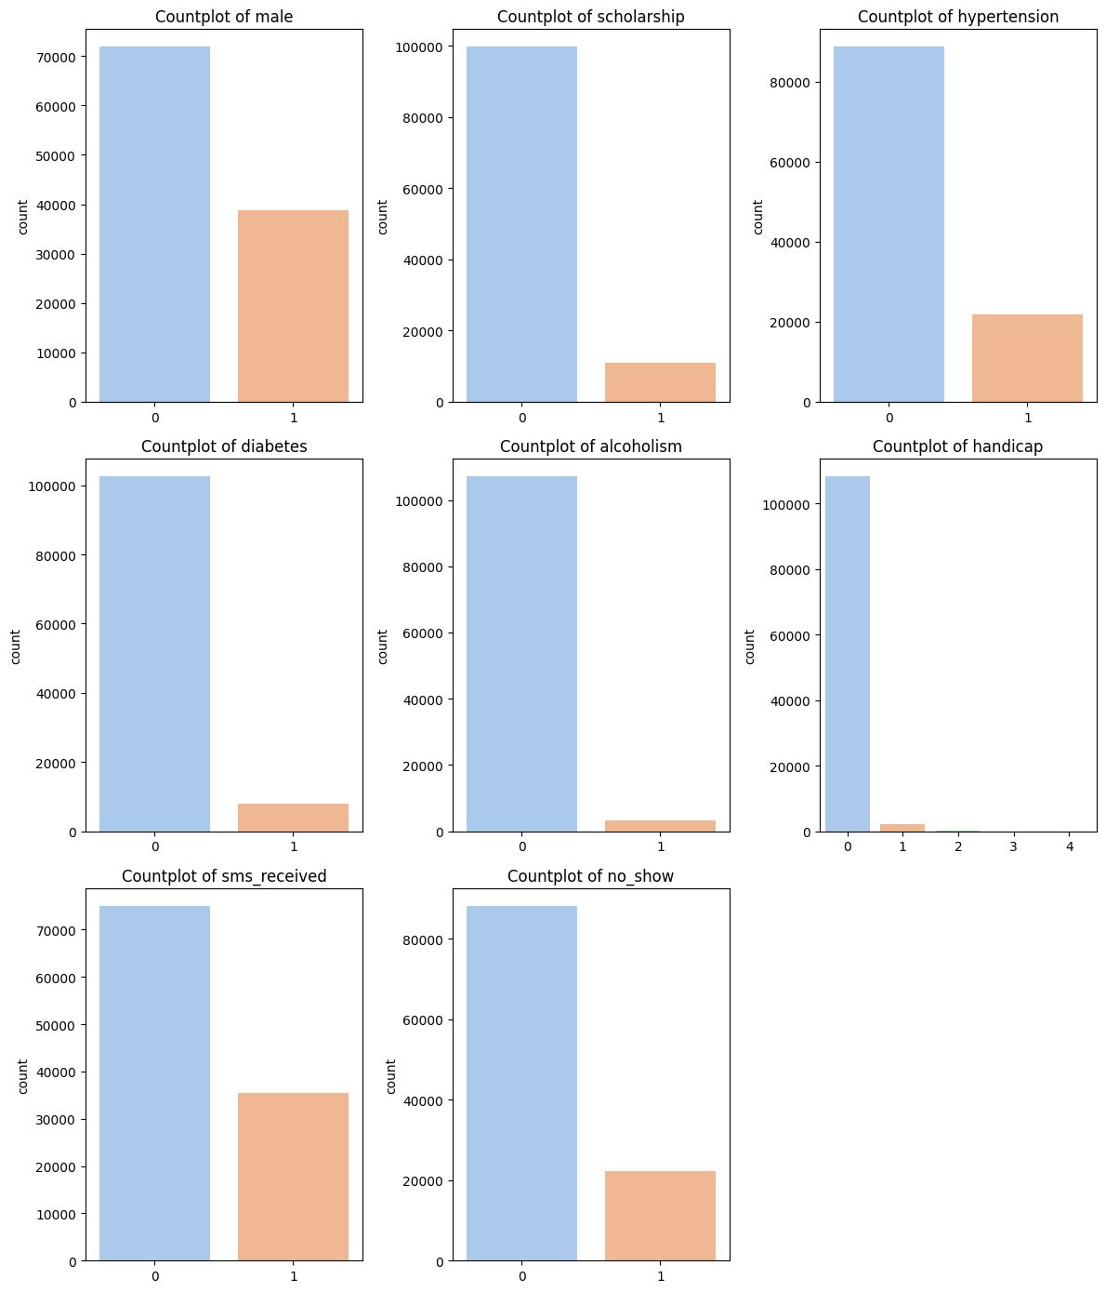
Distribution of Categorical Variables
Surprising uneven gender ratio
Around 10% participate in the Scholarship program
Handicap has 4 levels of handicap
Around a third of patients received sms reminders
Only 20% no-shows
Varying range of disease imbalance

Slide 14
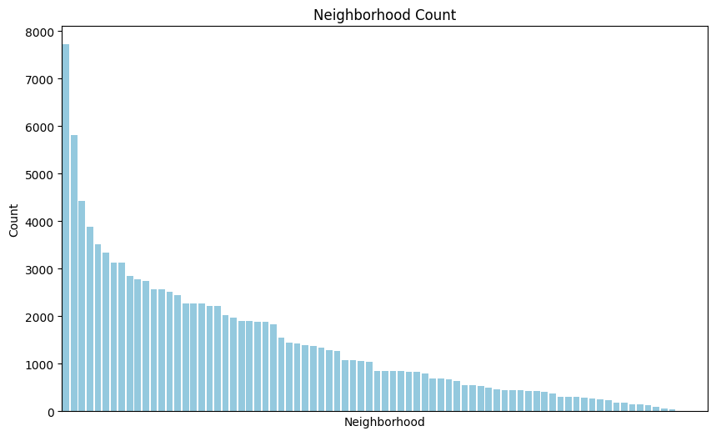
Distribution of Neighborhoods
Extremely imbalanced, difficult to extract data from

Slide 15
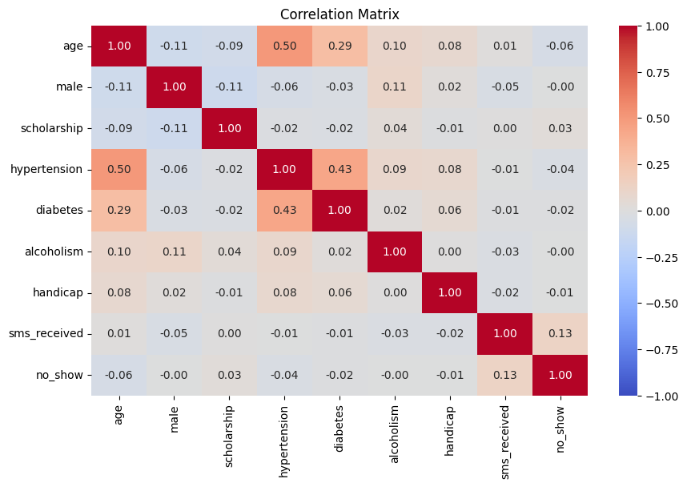
Correlation Matrix
Avoid multicollinearity
Choose predictor variables
Hypertension significantly correlated with diabetes and age
SMS seems to have a positive relationship with the target variable

Slide 16
Data Preparation

Slide 17

Drop negative values in age
Convert non-0 handicap values to 1
Explore age at 115 and handicap greater than 1
Drop the time aspect of the date columns

Slide 18
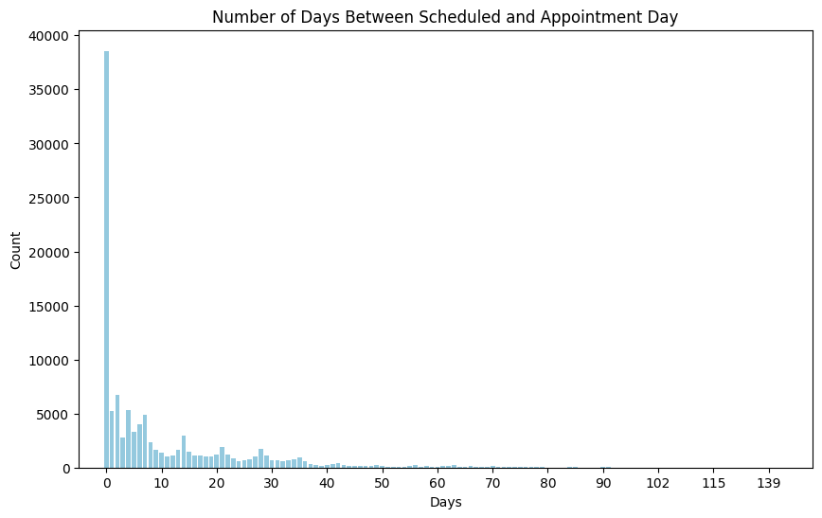
Feature Engineering
Create Time-Between Column
Create Same-Day Column

Slide 19
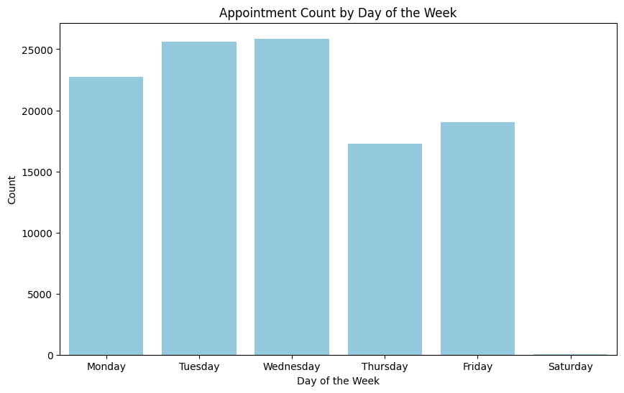
Day of Week Distribution
Create day of week column and OHC it
No Sunday appointments
Very few Saturday appointments

Slide 20

Model Building and Selection

Slide 21
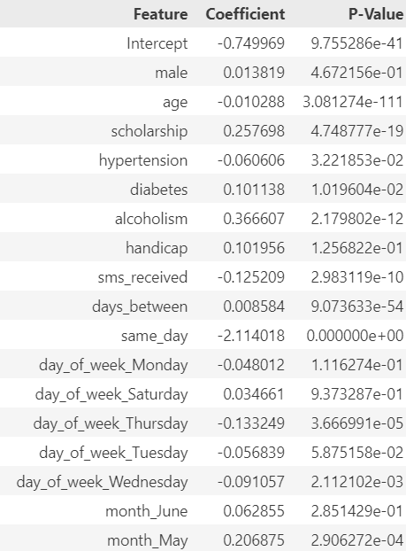
Days of the week and month have relatively high p-values and merely overcomplicate the model
Remove all weekdays and months

Slide 22
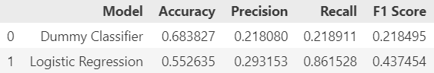
Build a dummy model predicting the ratio of the target variable
Build a logistic regression model to predict the target variable

Slide 23
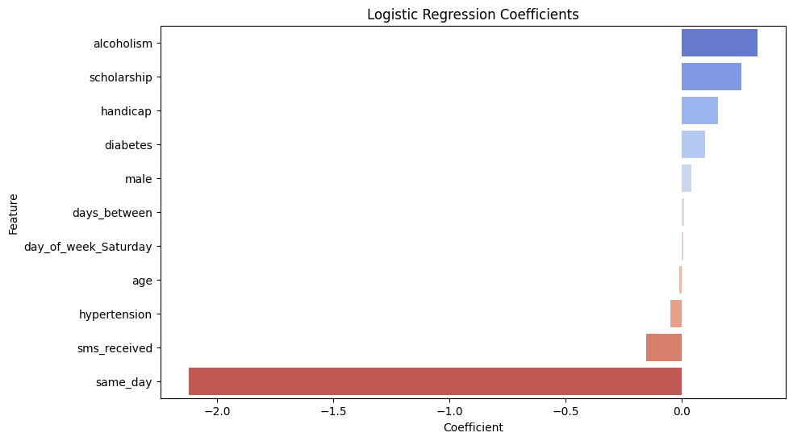
Split by same day
Same Day is the largest factor by far
Likely collinear with days between
Likely confounding with SMS received
Split the data and repeat

Slide 24
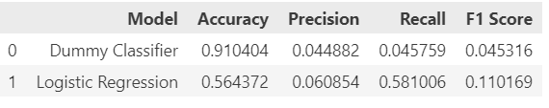
Same Day Appointments Model Comparison
Major loss of accuracy
Lost the most important predictors, days between and sms reminder
Do not use unless need recall
Do not rely on it for major decisions

Slide 25
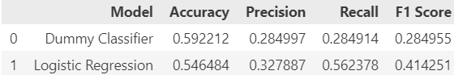
Non-Same Day Appointments Model Comparison
Much better model
Similar accuracy with much better metrics
Still not large enough to rely on for major decisions

Slide 26
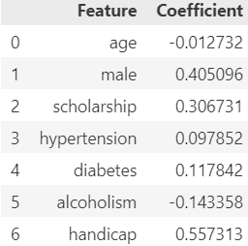
Review Coefficients and Predictions
Negative correlation with SMS reminders
Real terms: 15% decrease in the chance of no-shows
Age and Hypertension have negative relationship with target variable
They are correlated so individual coefficients may be unreliable
Scholarship has a positive relationship with no-shows. Factors may be, higher poverty rates, more children or no OOP payment.

Slide 27
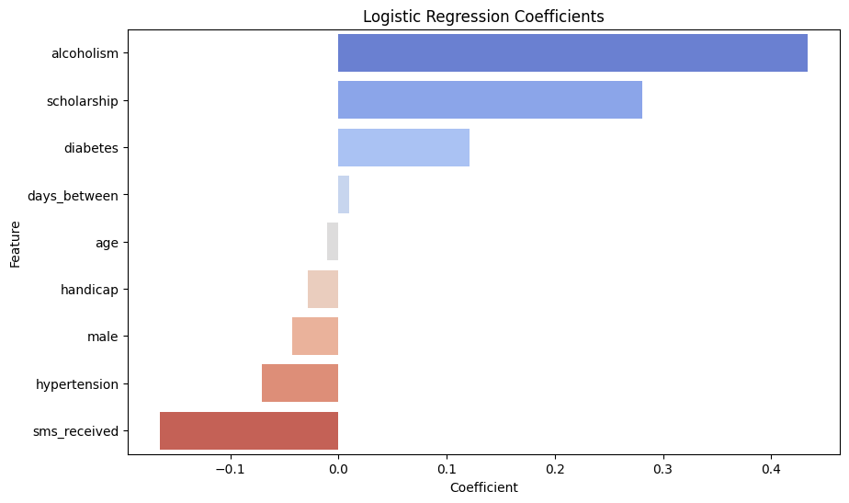

Slide 28

Findings

Slide 29
Results
Same Day appointments are by far the most likely to be kept
Impossible to reliably predict the rare no-shows on same day appointment using this data, possibly due to last-minute emergencies
Non-Same Day are harder to predict
SMS Reminder most important
Age/Hypertension is likely to keep
Alcoholism has a negative relationship with no-shows
Brazilian Scholarship Program Too

Slide 30
Recommendations and Limitations
Providers can ensure their schedule does not have back to back high-risk patients, alcoholism or scholarship
Schedule older patients around higher risk patients
Providers should utilize SMS reminders
Data does not contain many variables
Data is constrained to one city, and 7 week time span.
Socioeconomic factors differ

Slide 31
Sources
https://www.kaggle.com/datasets/joniarroba/noshowappointments/data

